Slide 1

GWU Data Analytics & Visualization Bootcamp, Spring/Summer 2021
OpenWeather Air Quality Index (AQI) Analysis
By Michelle Reilly & Elodie Slawinski
Notes:
Presenter: Elodie
Presentation notes:
Greetings
Presentation of our final project s the culmination of 6 months of intense studying
We decided to work on a topic that is very sensitive nowadays, which is Air Pollution
Basic background on OpenWeather and API

Slide 2
What to expect?
1
2
3
4
✓ Selected topic and the reason why we selected this topic
✓ Source of data and the questions we hope to answer with the data
✓ Description of the data exploration phase of the project
✓ Description of the analysis phase of the project
Notes:
Presenter: Michelle
Presentation notes:
Structure of our briefing
What to expect
We will highlight some of our challenges as well as how this analysis could be updated for future needs

Slide 3
AQI Analysis Overview
Notes:
Presenter: Michelle
Presentation notes:
N/A

Slide 4
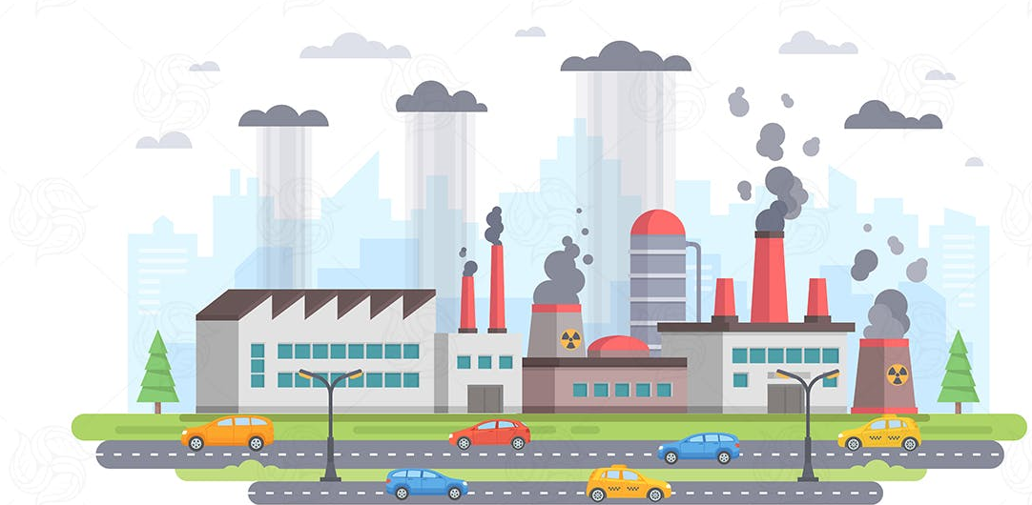
Selected Topic
Air Quality Index (AQI) Analysis
The U.S. Environmental Protection Agency (EPA) establishes an AQI for several major air pollutants regulated by the Clean Air Act.
As the world is battling global warming, our team decided to review and analyze AQIs for four different locations.
We captured historical data on the following pollutants:
Carbon monoxide (CO)
Nitrogen monoxide (NO)
Nitrogen dioxide (NO2)
Ozone (O3)
Sulphur dioxide (SO2)
Ammonia (NH3)
Particle pollution (also known as particulate matter, specifically PM2.5 and PM10)
https://www.epa.gov/sites/default/files/2015-10/documents/ace3_criteria_air_pollutants.pdf
Notes:
Presenter: Michelle
Presentation notes:
We were curious to see how AQI has evolved over the last ~ 12 months, throughout COVID, and whether the reduction of traffic, had an impact, if any, on the AQI
What is the Air Quality Index?
It is measured from 1 to 5, with 5 being the worst air quality
Beyond AQI, OpenWeather also captures historical information about 8 pollutants listed on this slide
Each of these pollutants has a national air quality standard set by EPA to protect public health

Slide 5

Sources of Data
OpenWeather API
The OpenWeather Air Pollution API provides current, forecast and historical air pollution data for any coordinates on the globe
OpenWeather classifies Air Quality per the scale below:
1 = Good
2 = Fair
3 = Moderate
4 = Poor
5 = Very Poor
OpenWeather's API considers elements beyond the basic Air Quality Index (AQI).
Historical data is accessible from 27th November 2020
Our sample includes 4 selected locations:
Alaska
California
Washington, DC
Massachusetts
We then created 4 different API requests for the 4 locations and captured the AQI data into a separate CSV
Finally, we loaded into Tableau for visualization purposes
Notes:
Presenter: Michelle
Presentation notes:
We will review some of the challenges we encountered in finding historical AQI data
We decided to use OpenWeather’s AQI through an API
However, OpenWeather’s only allows to track historical AQI since 11/20/20
We set up an API for 4 different locations, for comparison purposes (incl. DC since most of us live in DC)
The OpenWeather AQI requires to use of latitudes and longitudes of specific places.
Therefore, we used lats and longs from a Google database listing lats and logs of the centers of all 50 states and DC
Future researchers could make this API more dynamic to include data of 50 states and DC
(From README)
✓ Description of the data exploration phase of the project:
After settling on a topic we found interesting and relevant, we tried to google and research data that aligned with our interests.
We found lots of sources and projects done for India, and then more specific cities elsewhere, but not what we wanted in terms of measurements from our area. We found what we thought was perfect source from the EPA, but ran into technical issues working with it’s API when trying to collect information past one day’s worth of data.
Then we found OpenWeather AQI API, looked into the documentation, the data samples, the lat/long way to tailor data outputs. After pairing it with a google data set of 51 lat/longs across the US, we were able to explore different options for pairing down our sample.

Slide 6
Which of the below air pollutants have the most impact of the overall AQI?
Carbon monoxide (CO)
Nitrogen monoxide (NO)
Nitrogen dioxide (NO2)
Ozone (O3)
Sulphur dioxide (SO2)
Ammonia (NH3)
Particle pollution 1 (PM2.5)
Particle pollution 2 (PM10)
Notes:
Presenter: Elodie
Presentation notes:
As discussed earlier, OpenWeather also tracks the levels of 8 pollutants in the atmosphere
Our goal was to evaluate which of these pollutants had the most impact on the AQI

Slide 7

Hypothesis Testing
Air Quality Index (AQI) Analysis
By running various machine learning models (namely RandomForest and AdaBooster), we tried to assess whether specific pollutants have more or less impact of the AQI.
Moreover, we wanted to compare various locations’ pollutants to see if there were any differences at the location level.
Notes:
Presenter: Elodie
Presentation notes:
As I mentioned, our main goal is this analysis was to analyze the levels of each of the 8 pollutants, and to run them through our machine learning models to see which one impacted AQI the most
Using the historical data (saved as a CSV), we uploaded the whole data set into Tableau to develop visualizations which enabled us to create a story in Tableau (tableau is one of the most popular tool to summarize data in visual formats, without the need to do a lot of coding)

Slide 8
AQI Analysis Summary
Notes:
Presenter: Elodie
Presentation notes:
N/A

Slide 9
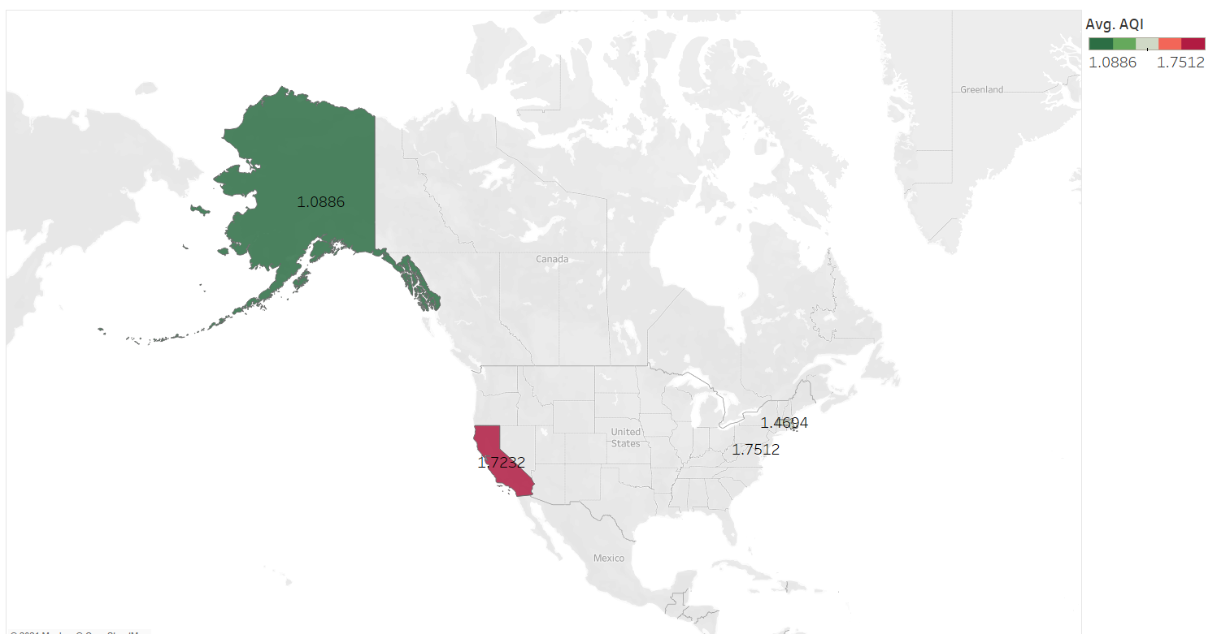
Selected Locations for our AQI Analysis
USING TABLEAU
Our team selected four locations for comparison purposes:
Alaska
California
Washington, DC
Massachusetts
This visualization summarizes the Air Quality Index (AQI) average score since November 2020.
Tableau Story Link: https://public.tableau.com/app/profile/elo.sla/viz/Final_Project_AQI_Story/AQIStory?publish=yes
Notes:
Presenter: Elodie
Presentation notes:
Our first visualization is a map of the 4 locations and the corresponding average AQI
The color defines the average AQI, with green being the “cleanest” air (in Alaska, without much surprise), and red being the worst (in California)
It is hard to see the color for DC, but with an average of 1.76, it actually had worse air quality than MA

Slide 10
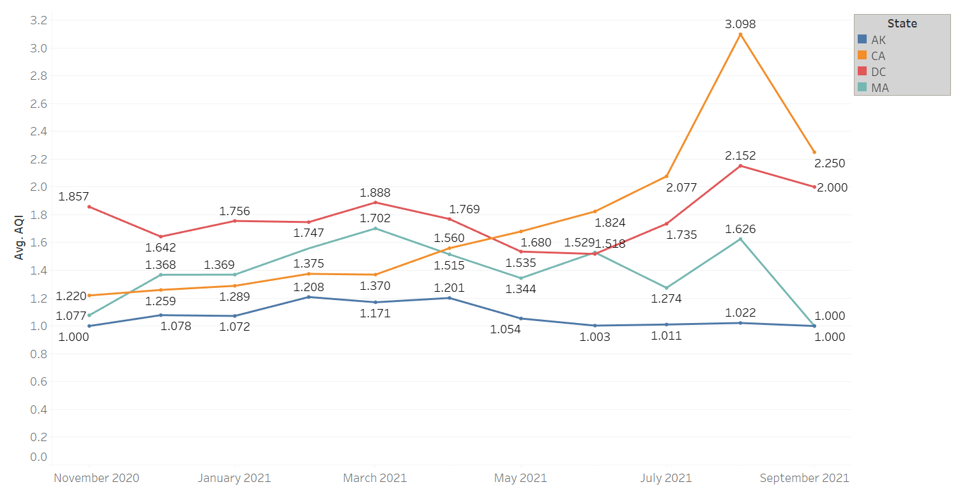
Historical AQI By Location
USING TABLEAU
This visualization summarizes the Air Quality Index (AQI) score by month and by location since November 2020.
Average AQIs have been steady between November 2020 and July 2021, with a significant increase in August 2021, particularly in California (that is likely due to the fire activity across the state in the summer of 2021).
Tableau Story Link: https://public.tableau.com/app/profile/elo.sla/viz/Final_Project_AQI_Story/AQIStory?publish=yes
Notes:
Presenter: Elodie
Presentation notes:
This chart summarizes all 4 locations’ average AQI since November 2020, by month
It allows to see which location had the worst and best AQI in the last year
The blue line is for Alaska, orange is California, red is DC and turquoise is Massachusetts

Slide 11
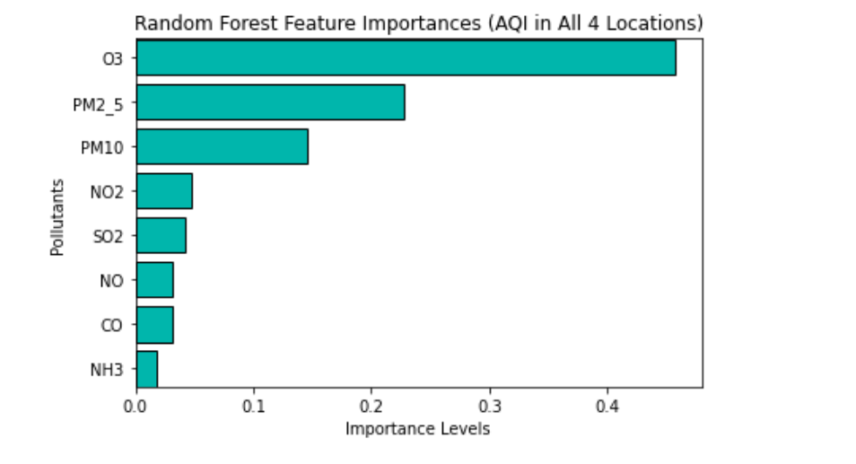
Impact Analysis Across the Four Locations
USING OUR MACHINE LEARNING MODEL
After they were scaled, we can see O3 has the most impact of our X (feature values) on the AQI (Y output) in our sample size of the four locations.
Notes:
Presenter: Michelle
Presentation notes:
- Our RandomForestClassifier machine learning model allowed us to see that Ozone levels (O3) had the most impact on AQI, when looking at the 4 locations together
- Decision tree, many little samples and taking a winner-take all approach

Slide 12
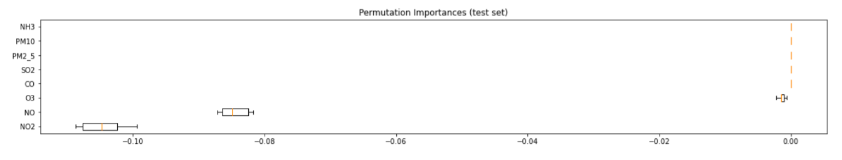
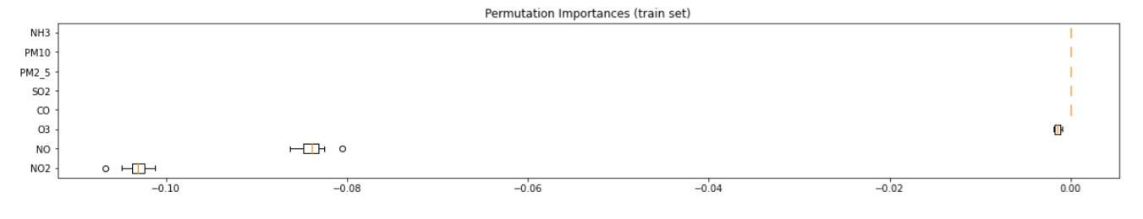
Permutation Importances (on AdaBoost Model)
USING OUR MACHINE LEARNING MODEL
Notes:
Presenter: Michelle
Presentation notes:
These charts show the results of our analysis using the AdaBoost machine learning model

Slide 13
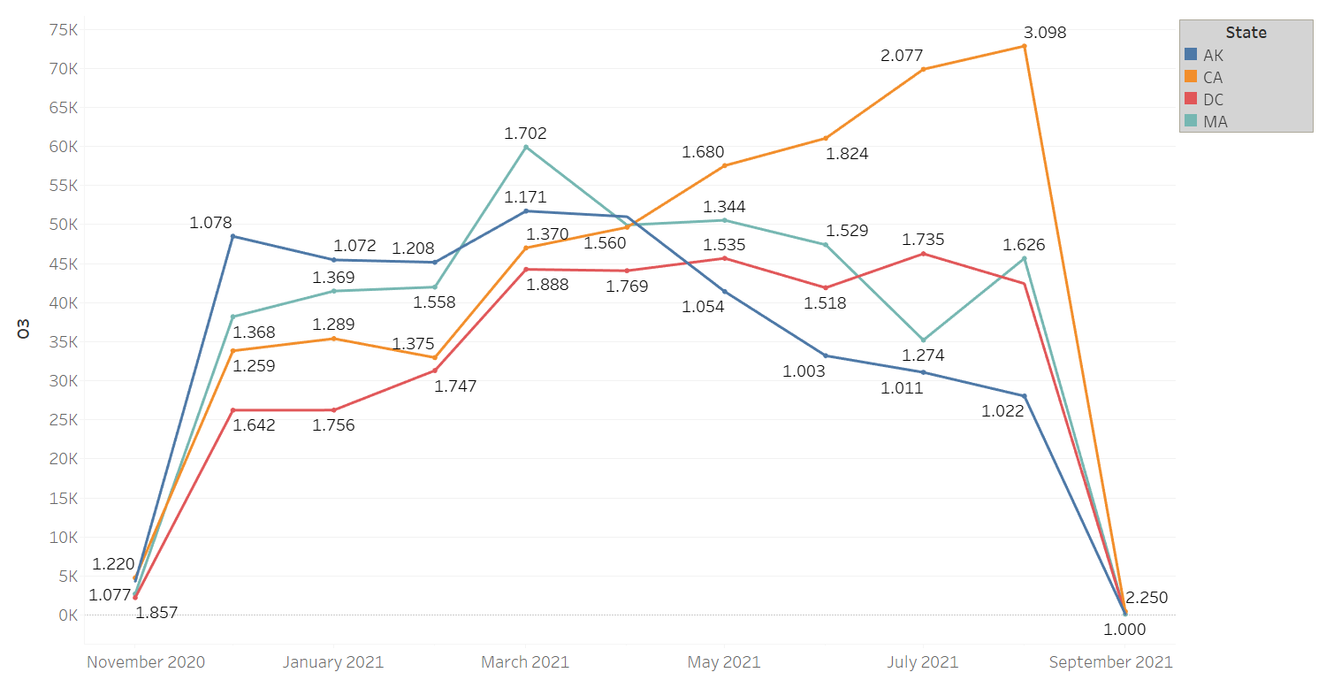
Historical Ozone (O3) Levels by Location
USING TABLEAU
This visualization summarizes the ozone level by location and by month.
California’s ozone levels have steadily increased since April 2021.
Tableau Story Link: https://public.tableau.com/app/profile/elo.sla/viz/Final_Project_AQI_Story/AQIStory?publish=yes
Notes:
Presenter: Elodie
Presentation notes:
We did a deep dive on the O3 historical levels by location since per our ML model, O3 is the pollutant that had the most impact on the overall AQI score
Again, on these charts, the colors define the locations, with blue for Alaska, orange for California, red for DC and turquoise for Massachusetts

Slide 14
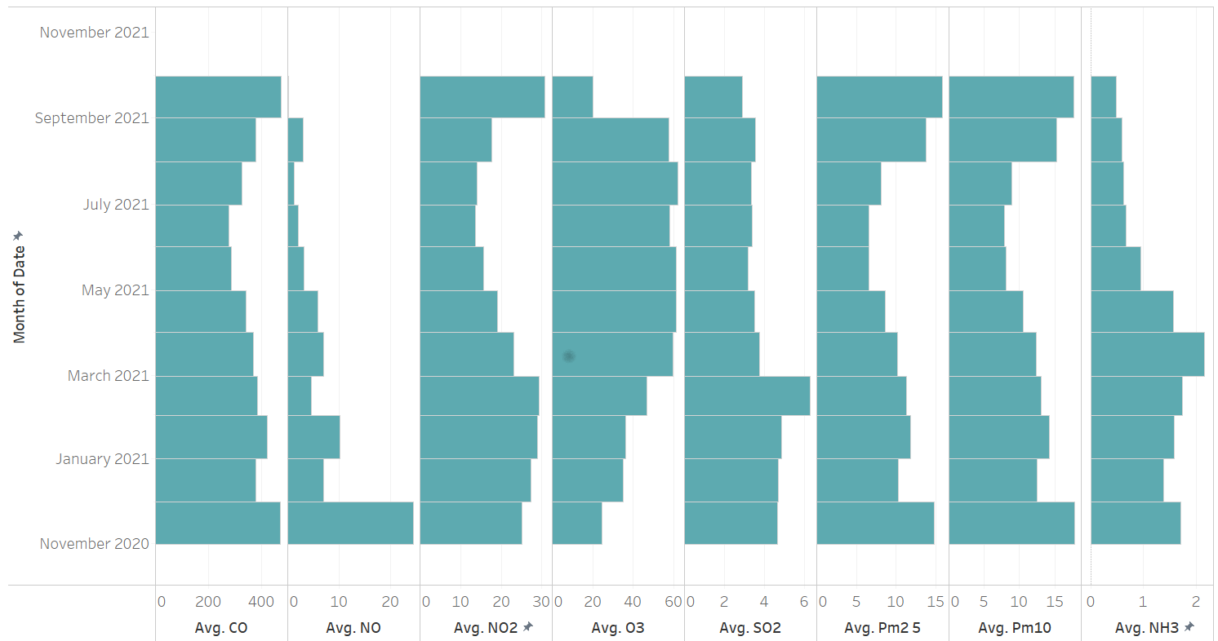
Historical Pollutants by Month in DC
USING TABLEAU
This visualization summarizes the 8 pollutants tracked by OpenWeather in Washington, DC since November 2020.
While the scales of each pollutant vary, this visualization helps understand how each pollutant increase or decrease over time.
Tableau Story Link: https://public.tableau.com/app/profile/elo.sla/viz/Final_Project_AQI_Story/AQIStory?publish=yes
Notes:
Presenter: Elodie
Presentation notes:
Since most of us live in the DC area, we thought we would highlight the historical levels of all 8 pollutants that are tracked by OpenWeather
The first column on the left is CO (carbon monoxide)
The vertical axis are the months
We would like to point out the 4th bar chart (from left), which captures the O3 levels in DC

Slide 15
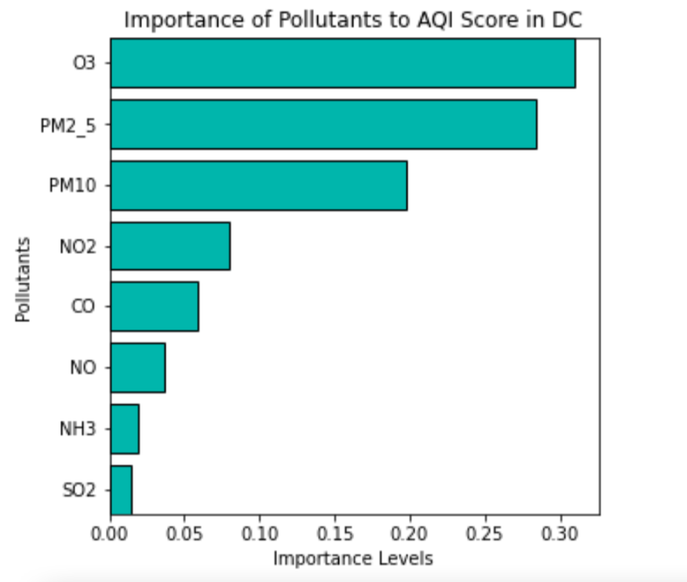
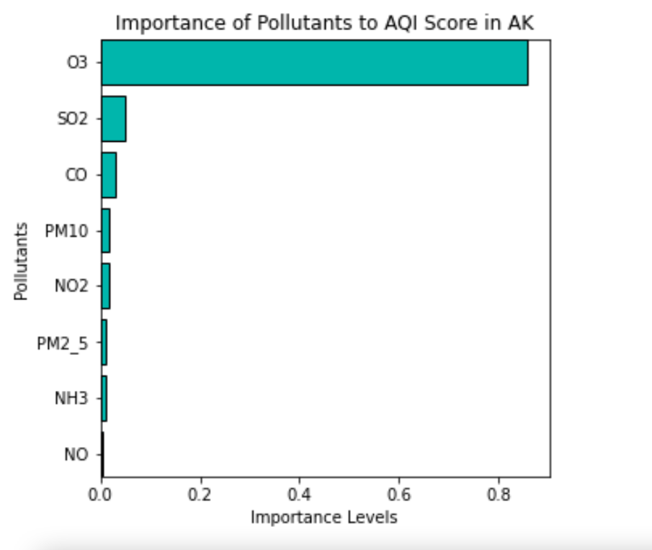
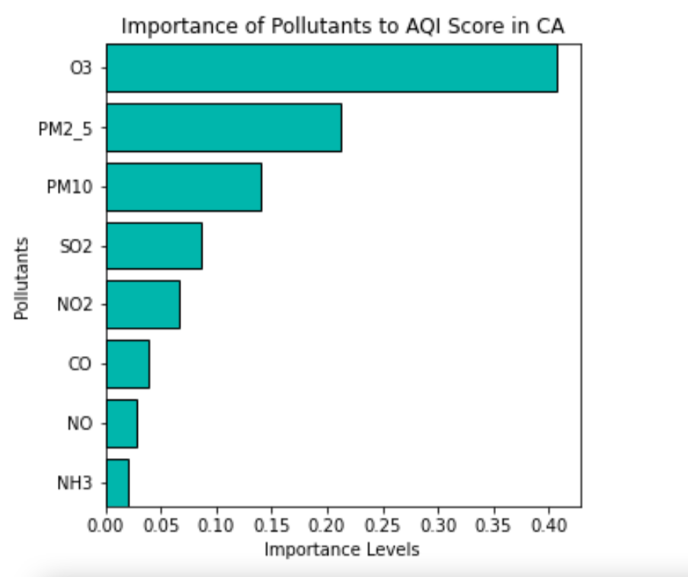
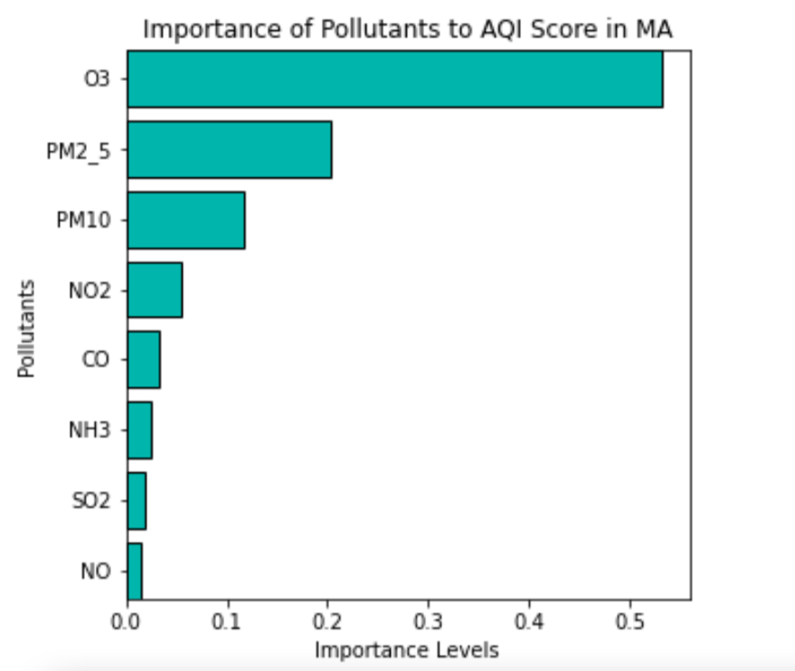
Closer Look Per Location
USING OUR MACHINE LEARNING MODEL
Notes:
Presenter: Michelle
Presentation notes:
We believe that it would be worth making this more dynamic for future research using the full advantage of the links
This chart summarizes the importance of each pollutant on the AQI score by location
O3 plays a much more important role in Alaska than in DC

Slide 16



Any questions for the team?
Elodie Slawinski
Michelle Reilly
elodiecslawinski@gmail.com
+1-240-481-2175
michelleeileenreilly@gmail.com
+1-305-965-0030
Notes:
Presenter: Michelle + Elodie
We thank you for your time and attention, and hope you learned a lot about Air Quality
We should now all move out of DC and move to AK ☺
We would like to thank Sohail, Heather and Logan for their continued support throughout the semester, and particularly on this final project. We wouldn’t be where we are without all of you.

